Slide 1
Prayer – Paul prays for the saints
Ephesians 1 v 15 -23, Philippians 1 v 3 -11

Slide 2
Ephesians 1 v 15 -23
¹⁵ For this reason, because I have heard of your faith in the Lord Jesus and your love^{[f]} towards all the saints, ¹⁶ I do not cease to give thanks for you, remembering you in my prayers, ¹⁷ that the God of our Lord Jesus Christ, the Father of glory, may give you a spirit of wisdom and of revelation in the knowledge of him, ¹⁸ having the eyes of your hearts enlightened, that you may know what is the hope to which he has called you, what are the riches of his glorious inheritance in the saints,

Slide 3
Ephesians 1 v 15 -23
¹⁹ and what is the immeasurable greatness of his power towards us who believe, according to the working of his great might ²⁰ that he worked in Christ when he raised him from the dead and seated him at his right hand in the heavenly places, ²¹ far above all rule and authority and power and dominion, and above every name that is named, not only in this age but also in the one to come. ²² And he put all things under his feet and gave him as head over all things to the church, ²³ which is his body, the fullness of him who fills all in all.

Slide 4
Philippians 1 v 3 -11
³ I thank my God in all my remembrance of you, ⁴ always in every prayer of mine for you all making my prayer with joy, ⁵ because of your partnership in the gospel from the first day until now. ⁶ And I am sure of this, that he who began a good work in you will bring it to completion at the day of Jesus Christ. ⁷ It is right for me to feel this way about you all, because I hold you in my heart, for you are all partakers with me of grace,^{[d]} both in my imprisonment and in the defence and confirmation of the gospel. ⁸ For God is my witness, how I yearn for you all with the affection of Christ Jesus. ⁹ And it is my prayer that your love may abound more and more, with knowledge and all discernment, ¹⁰ so that you may approve what is excellent, and so be pure and blameless for the day of Christ, ¹¹ filled with the fruit of righteousness that comes through Jesus Christ, to the glory and praise of God.

Slide 5
Spirit of wisdom and of revelation in the knowledge of him
that you may know what is the hope to which he has called you
the riches of his glorious inheritance in the saints,
immeasurable greatness of his power towards us
your love may abound more and more in knowledge and depth of insight,
able to discern what is best
may be pure and blameless for the day of Christ
filled with the fruit of righteousness

Slide 6
1 Thessalonians 5 v 16 -18
16 Rejoice always, 17 pray without ceasing, 18 give thanks in all circumstances; for this is the will of God in Christ Jesus for you.

Slide 7


Slide 8
John 16 v 12 - 15
12 “I still have many things to say to you, but you cannot bear them now. 13 When the Spirit of truth comes, he will guide you into all the truth, for he will not speak on his own authority, but whatever he hears he will speak, and he will declare to you the things that are to come. 14 He will glorify me, for he will take what is mine and declare it to you. 15 All that the Father has is mine; therefore I said that he will take what is mine and declare it to you.

Slide 9
Romans 12 v 1 - 2
I appeal to you therefore, brothers,[a] by the mercies of God, to present your bodies as a living sacrifice, holy and acceptable to God, which is your spiritual worship.[b] 2 Do not be conformed to this world,[c] but be transformed by the renewal of your mind, that by testing you may discern what is the will of God, what is good and acceptable and perfect.[d]

Slide 10
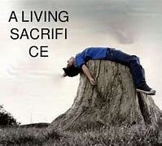

Slide 11
1 John 3 v 2
2 Beloved, we are God's children now, and what we will be has not yet appeared; but we know that when he appears[a] we shall be like him, because we shall see him as he is.

Slide 12
Romans 8 v 10-12
10 But if Christ is in you, although the body is dead because of sin, the Spirit is life because of righteousness. 11 If the Spirit of him who raised Jesus from the dead dwells in you, he who raised Christ Jesus from the dead will also give life to your mortal bodies through his Spirit who dwells in you.

Slide 13
John 3 v 16
16 “For God so loved the world,[i] that he gave his only Son, that whoever believes in him should not perish but have eternal life.

Slide 14
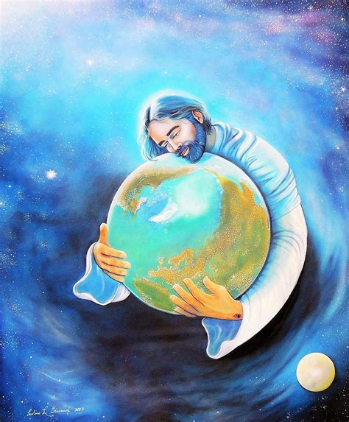

Slide 15
Philippians 4 v 8
Finally, brothers, whatever is true, whatever is honourable, whatever is just, whatever is pure, whatever is lovely, whatever is commendable, if there is any excellence, if there is anything worthy of praise, think about these things.

Slide 16
Philippians 1 v 27
Only let your manner of life be worthy of the gospel of Christ, so that whether I come and see you or am absent, I may hear of you that you are standing firm in one spirit, with one mind striving side by side for the faith of the gospel,

Slide 17
Spirit of wisdom and of revelation in the knowledge of him
that you may know what is the hope to which he has called you
the riches of his glorious inheritance in the saints,
immeasurable greatness of his power towards us
your love may abound more and more in knowledge and depth of insight,
able to discern what is best
may be pure and blameless for the day of Christ
filled with the fruit of righteousness

